Slide 1



ICTC Training program
CC-BY-NC-SA

Slide 2
Versioning
Version | Date de version | Auteur / Contributeurs | Nature des modifications
2 | 2017-03-01 | Carolandrea Guerrero Mickaël Brard Julien Jézéquel-Bréard | Diffusion initiale
CC-BY-NC-SA

Slide 3
Sales Management
CC-BY-NC-SA

Slide 4
Outcomes
Ability to create and lead a high-performance sales organization
Developing and implementing an effective sales planning process
Managing products and services sales orders
Pricelist Management and discounts
Developing and managing an effective performance appraisal system and incentive / commissions management for the salesforce
CC-BY-NC-SA

Slide 5
Sales & Maketing Strategies
Sales Strategies
1. Marketing Planning
2. Sales Planning
3. Sales Management
4. Sales Performance
Salesforce Management
Channel Strategy
Sales Budget
Product Marketing Strategy
E-commerce Busines Strategy
Sales Process
Discount Management
E-Commerce Process
Sales Model Review (ROI)
Net Promoter Score
Customer Satisfaction
Business Strategy Review
Competitive Analysis
Customer Behavior
Positioning
CC-BY-NC-SA

Slide 6

Sales
Core Process
Features
Quotation Management
Set Quotations
Customer Management / Payment Terms
Online Quotations
Invoice Management
Invoicing process & Traking invoicing phases
Expense invoice linked to projects
Products & Prices Management
Products & Services Management
Set up taxes
Pricing & Discounting (Pricelist)
CC-BY-NC-SA

Slide 7





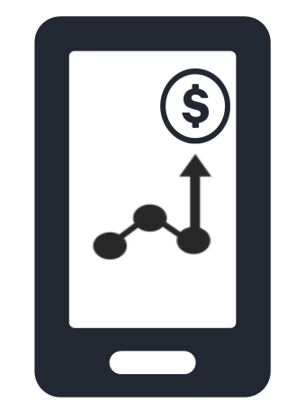

Sales Process Overview
Lead
Opportunity
Quote
Close Opportunity
&
Sales Process
Contact
Account
CC-BY-NC-SA

Slide 8
Customer Management
CC-BY-NC-SA

Slide 9
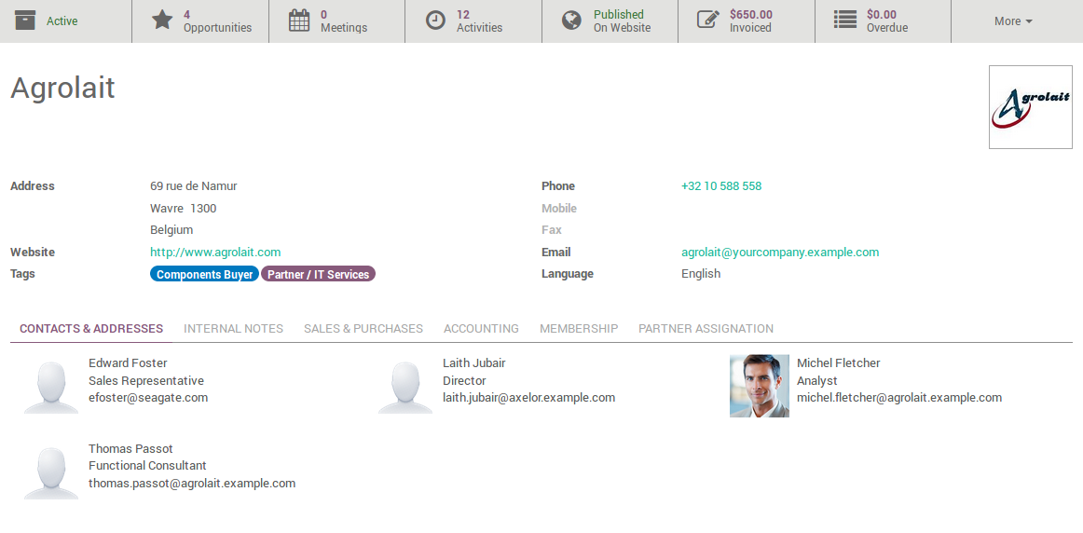
Sales – Customer Management
Customer basic information
Company Name
Address / Phone / Email
Website
Contacts & Addresses
Billing address
Delivery address
Sales Conditions
Delivery Method
Sales Price list
Accounting Conditions
Customer payment terms
Fiscal information
Accounting accounts
CC-BY-NC-SA
CC-BY-NC-SA

Slide 10
Exercise – Customer Management
15 min
TO DO
Complete the following information for the next customer :
Customer basic information
Company Name : Canadian Art Inc
Address : 1234 Rue Sant-Urbain, Montréal – Québec, H5V 1D3
Email: info@canadianart.inc
Contacts & Addresses
Billing address : 1234 Rue Sant-Urbain, Montréal – Québec, H5V 1D3
Delivery address #1: 100 Rue Beaubien O, Montréal – Québec
Delivery address #2: 2980 S Euclid Ave, Ontario – CA
Sales Conditions
Sales Price list: Public Pricelist (CAD)
Accounting Conditions
Customer payment terms: 30 Net Days
Fiscal information : Québec
CC-BY-NC-SA

Slide 11

Invoicing Process
1
Quotation
Sales Order
Invoice
Invoice on ordered quantity. This process is good for both services and products
2
Quotation
Purcharser Order
Sales Order
Invoice
Invoice based on products to be manufactured by suppliers
3
Quotation
Sales Order
Delivery
Invoice
Invoice based on delivered quantity
4
Contracts / Subscriptions
Invoice
Invoice is triggered periodically, automatically
5
eCommerce
Invoice
Invoice is triggered once the payment is received
6
Manual Invoice
Don’t need to manage the sales process (quotations), or the delivery of the products or services
Need to create a refund, give a discount, change an invoice created from a sales order or invoice something not related to your core business
CC-BY-NC-SA

Slide 12
Pricelist & Discounts
CC-BY-NC-SA

Slide 13
Workplan
Pricelist & discounts
A single sale price per product
Prices per customer segment
Advanced pricing & discounts
CC-BY-NC-SA

Slide 14


Pricing strategy to maximize revenue
Pricing is the process of determining what a company will receive in exchange for its products.
CC-BY-NC-SA

Slide 15
Sales – Pricing Strategies
COST-BASED PRICING
Activity – based Cost Accounting
Type of Costs
CUSTOMER VALUE-BASED PRICING
Product properties & functionality
Quality
Emotional
DEMAND-BASED PRICING
Price sensitivity
Estimating demand curves
Price elasticity of demand
Major Pricing Strategies
COMPETITION-BASED PRICING
Survival
Max. current profit
Max. market share
Max. market skimming
Product – Quality
Leadership
CC-BY-NC-SA

Slide 16
Sales – Pricing Tactics
Customer – segment pricing
Different customer segments pay different prices for the same product or service. (e.g. pricing strategies for students and senior citizens).
Product-form pricing (versioning)
Different versions of the product are priced differently even thought this difference does not apply with regard to their costs.
Image Princing
The same product is priced at two different levels based on image differences. (e.g. the same product in different presentations or packaging)
1
2
3
CC-BY-NC-SA

Slide 17
Sales – Pricing Tactics
Chanel Pricing
A product is priced depending on the distribution channel (e.g. Coca-Cola - Fine restaurant, fast-food chain, or vending machine).
Location Pricing
Same product is priced differently at different locations even though the cost is the same. (e.g. An airline company varies its seat prices according to customer preferences for different locations).
Time Pricing
Price varies by season, day, or hour (weekend vs. Weekdays « early bird customers).
4
5
6
CC-BY-NC-SA

Slide 18
Sales – Pricing discounts and allowances
Cash discount
Discounts given to cash, early or prompt payments.
Quantity discount
Discounts given to those who buy large volumes.
Seasonal discount
Discounts given to products or services that are out of season.
Trade discount
Discounts given by manufacturers to resellers (long term).
Allowances
Discounts given to gain reseller participation in special programs.
1
2
3
4
5
CC-BY-NC-SA

Slide 19
Workplan
Pricelist & discounts
A single sale price per product
Prices per customer segment
Advanced pricing & discounts
CC-BY-NC-SA

Slide 20

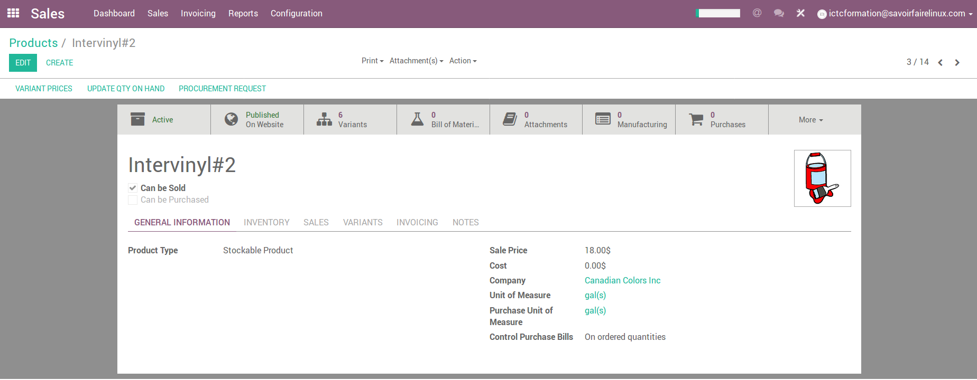
Sales – One price per product
Steps to set up sale price per product:
1. Set up sale price
2. Register price per product
Sales
Configuration
Settings
Pricing
Sale Price
Sales
Product Profile
CC-BY-NC-SA

Slide 21
Exercise – A single sale price per product
20 min
TO DO
Set up a new product manufactured by “Canadian Colors” :
Product : Home Hit
Product type : Stockable
Unit of mesure : gal(s)
Sale Price : 18 $CAN
Category product : Adhesives
CC-BY-NC-SA

Slide 22
Workplan
Pricelist & discounts
A single sale price per product
Prices per customer segment
Advanced pricing & discounts
CC-BY-NC-SA

Slide 23
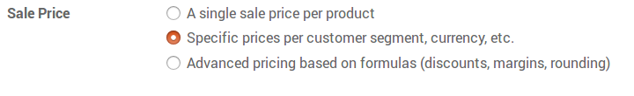
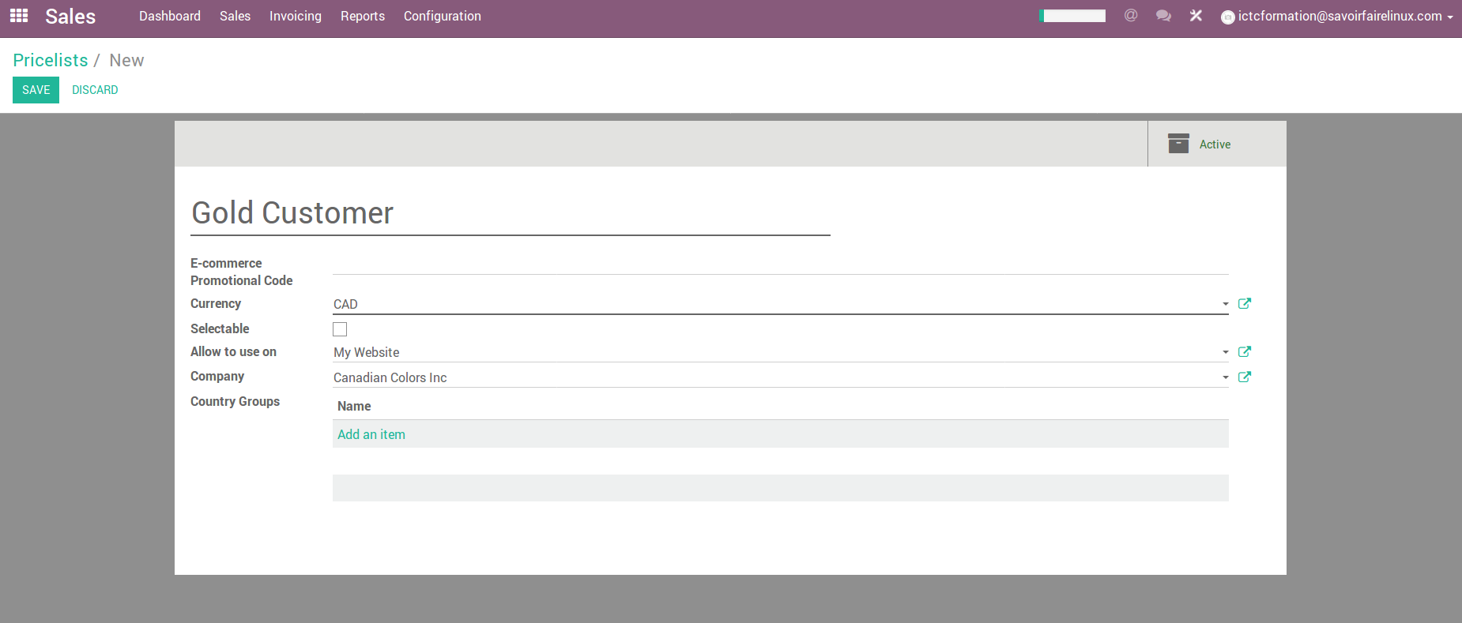
Sales – Specific prices per customer segment
Steps to set up prices per customer segment:
1. Set up sale price
2. Create list of price per customer segment
Configuration
Settings
Pricing
Sale Price
Sales
Sales
Configuration
Pricelists
CC-BY-NC-SA

Slide 24
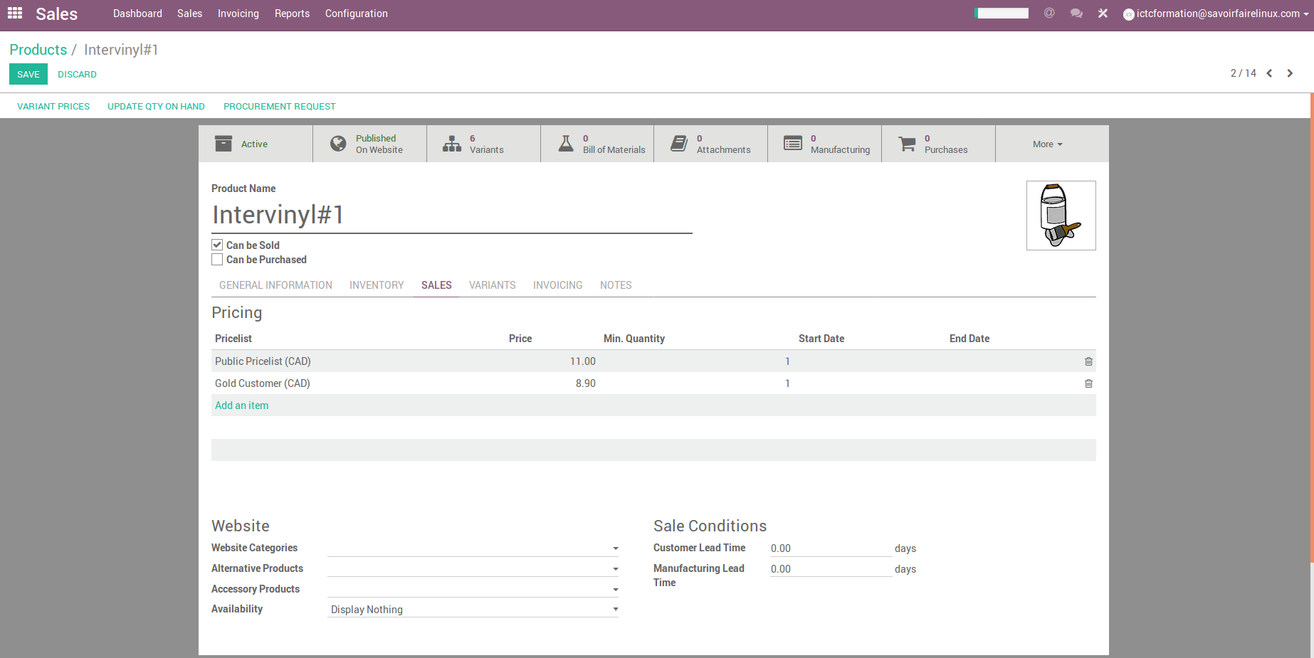
Sales – Specific prices per customer segment
3. Set up prices per customer segment
Sales
Product Profile
CC-BY-NC-SA

Slide 25
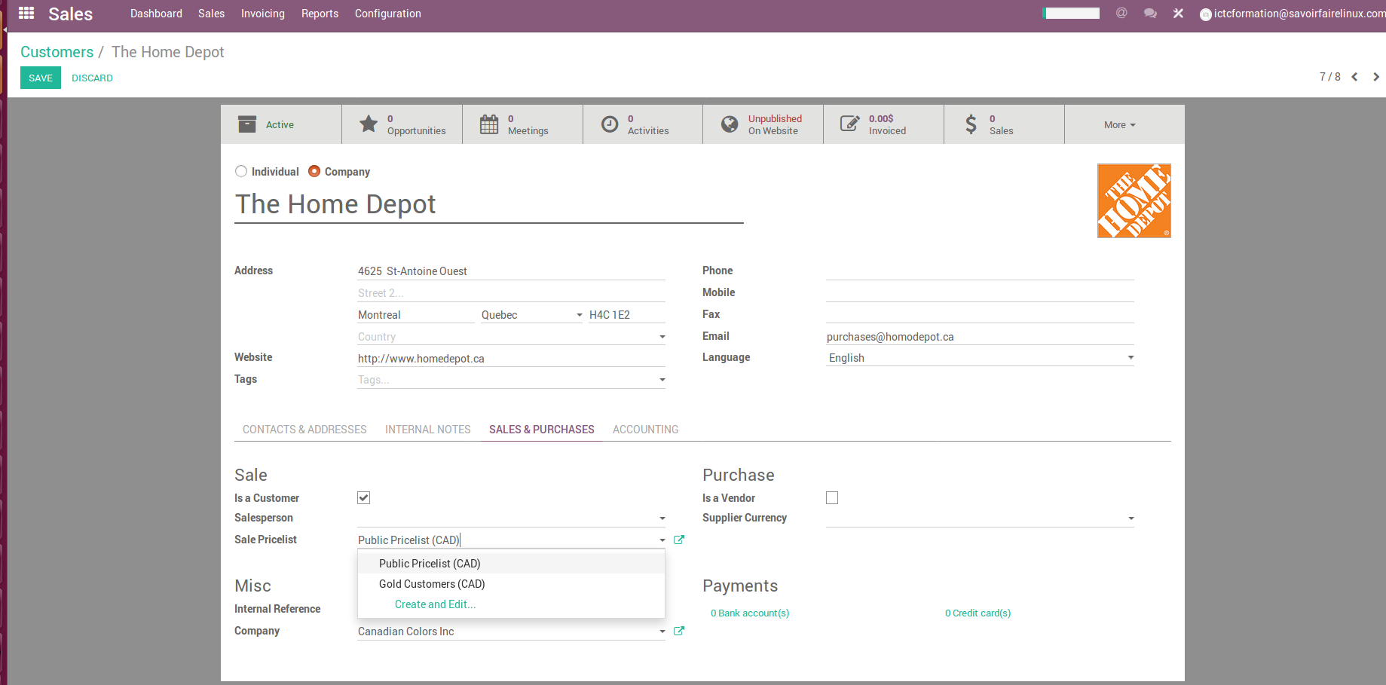
Sales – Specific prices per customer segment
4. Set up prices list for a customer
Sales
Customer Profile
CC-BY-NC-SA

Slide 26
Exercise – Prices per customer segment
30 min
According to the buying behavior, “Canadian Colors” classified its customers under the following segments :
General public & casual buyers
Resellers
Premium Customers
Platinum Customers
Gold Customers
TO DO
Create new price lists according to the information given above
Set up different prices per customer segment for :
Product : Intervinyl#2
Sale Price for Public : 18 $CAN
Sale Price for Premium Customers : 16 $CAN
Sale Price for Platinum Customers : 14 $CAN
Sale Price for Gold Customers: 11,50 $CAN
Create a new customer and assign a price list that you previously created
CC-BY-NC-SA

Slide 27
Workplan
Pricelist & discounts
A single sale price per product
Prices per customer segment
Advanced pricing & discounts
CC-BY-NC-SA

Slide 28

Sales – Advanced pricing & discounts
Steps to set up advanced pricing and discounts based on formulas:
1. Set up sale price
2. Set up discounts on sales order lines
Configuration
Settings
Pricing
Sale Price
Sales
Sales
Configuration
Quotations
&
Sales
CC-BY-NC-SA

Slide 29
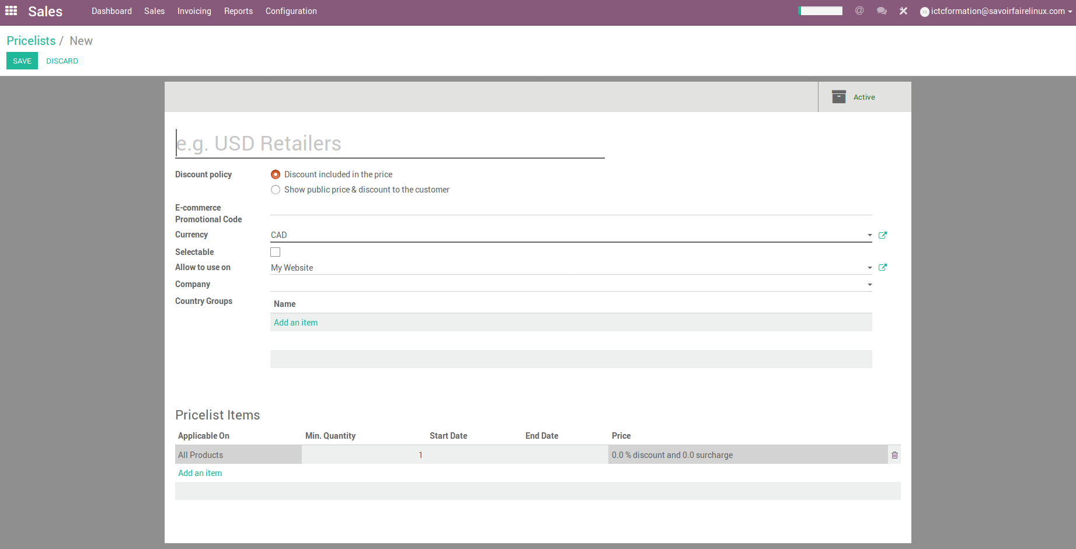
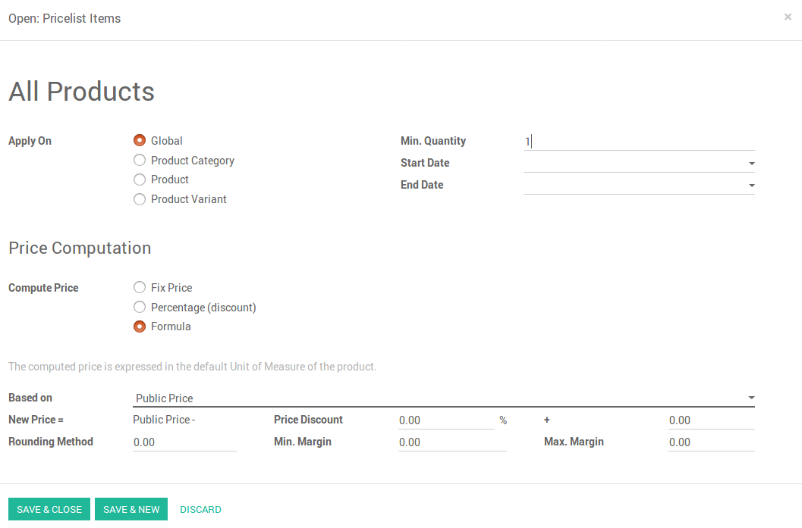
Sales – Advanced pricing & discounts
3. Set discounted price lists
CC-BY-NC-SA

Slide 30
Exercise – Sales price with discounts on sales orders
Canadian Colors sells solutions for the agricultural, industrial, construction and decoration sectors. In Ontario, the paint dealer « Paintcolor » showed interest in buying a lot of 300 units (each unit is a gallon of 6 kg) of the new ecological painting « HomeColor ». Canadian Colors would like to send them a quotation for those products with a sale price of 13$CAN per unit with a 7% discount for the purchase of the product more than 100 units + 20% discount of the Gold Customers interested in buying this new product. This discount is only valid for 30 days.
The product delivery will be at the customer's warehouse located in Ontario.
CC-BY-NC-SA

Slide 31
Exercise – Sales price with discounts on sales orders
60 min
TO DO
Register the new product “HomeColor”
Set up the pricelist for Gold Customers with discounts of this new product
Classify the customer « Paintcolor » with the pricelist Gold Customer
Using the above information, create a quotation and send it by email to this customer
Create a sales order
Generate partial deliveries from sales order
Generate an invoice
CC-BY-NC-SA

Slide 32
Quotation & Sales Order
CC-BY-NC-SA

Slide 33
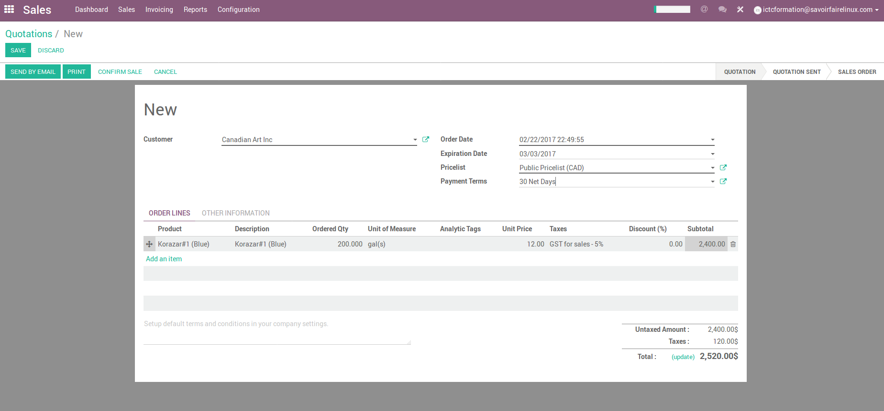
Sales – Quotation
CC-BY-NC-SA

Slide 34
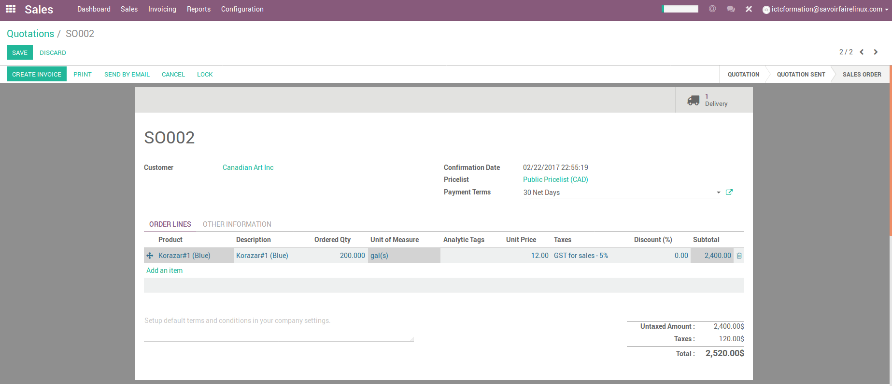
Sales – Sales Order
CC-BY-NC-SA

Slide 35
Delivery & Invoicing Management
CC-BY-NC-SA

Slide 36
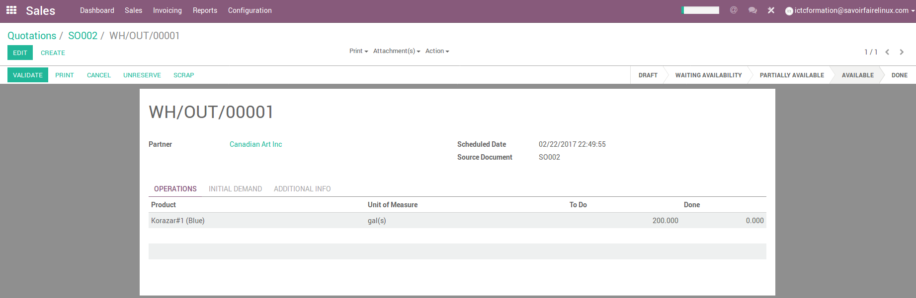
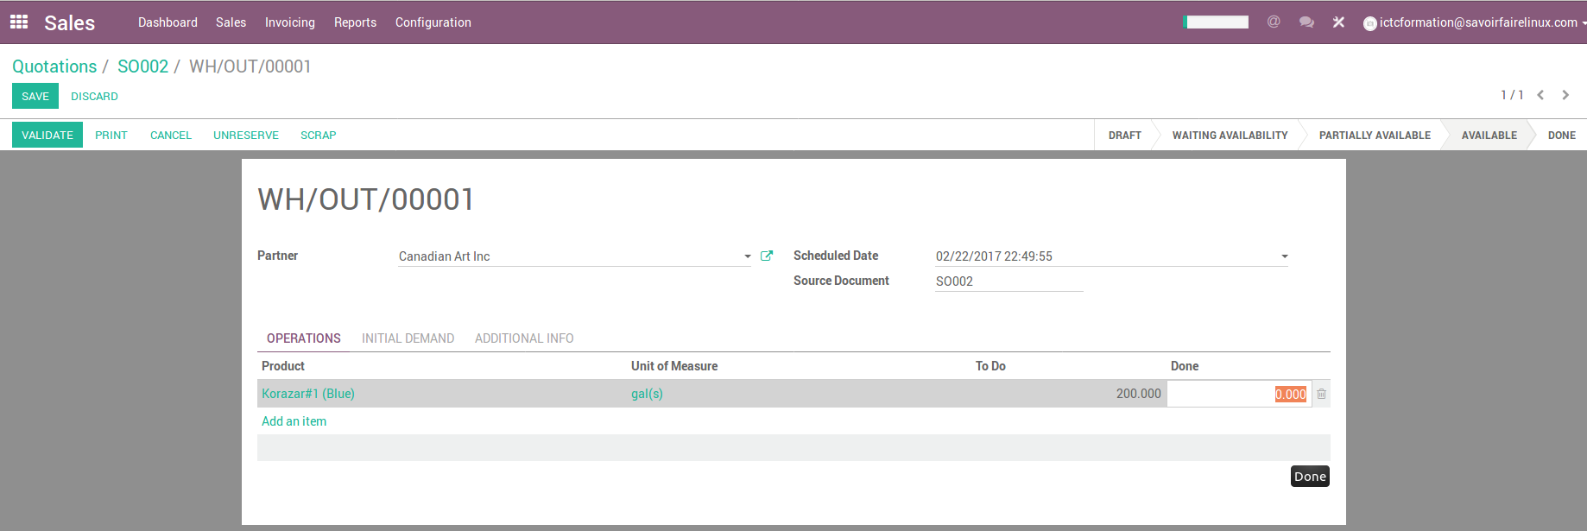
Sales – Delivery
1
CC-BY-NC-SA

Slide 37
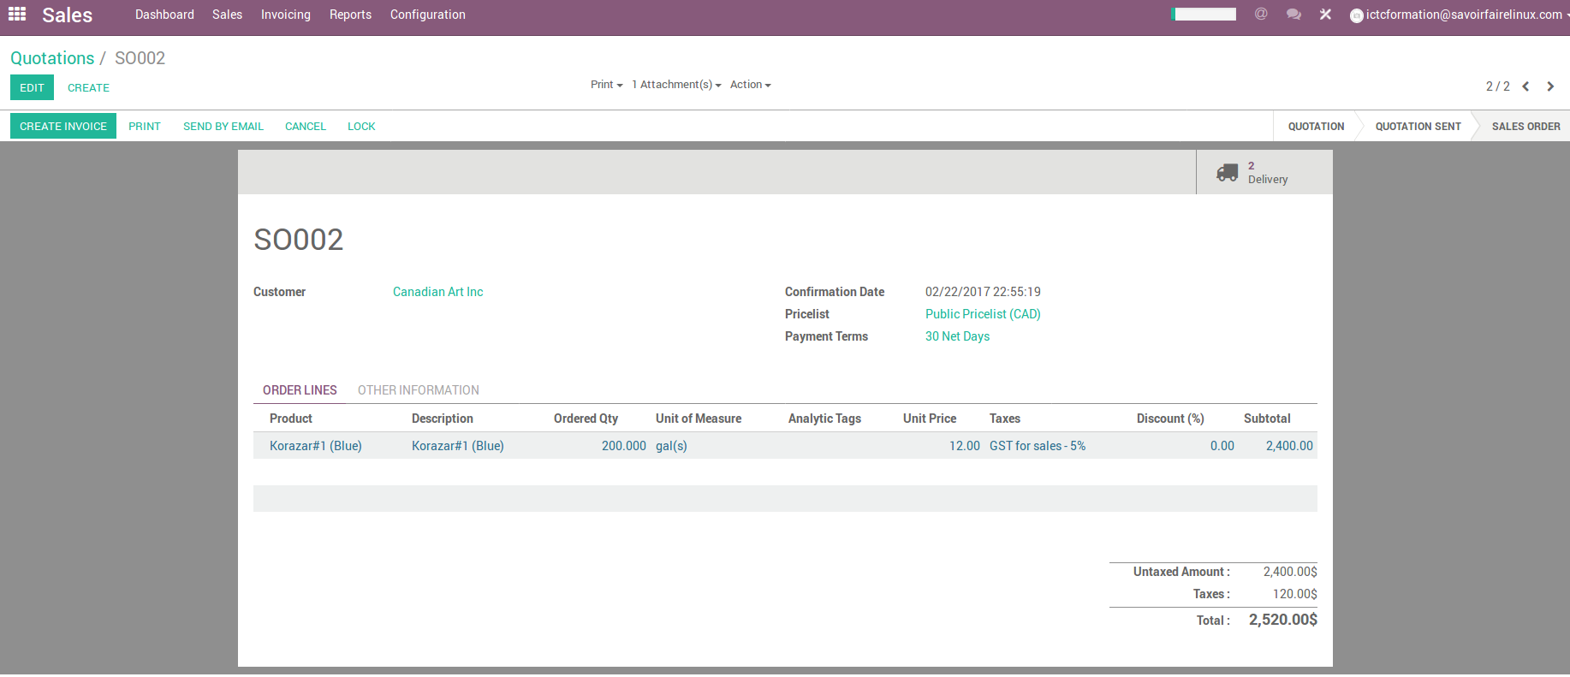
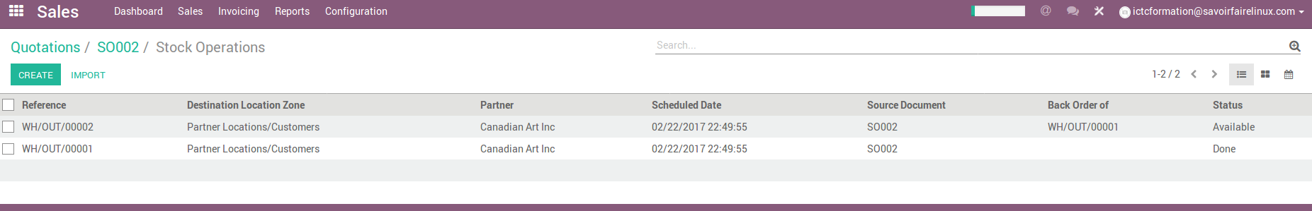
Sales – Delivery (Back Order)
CC-BY-NC-SA

Slide 38
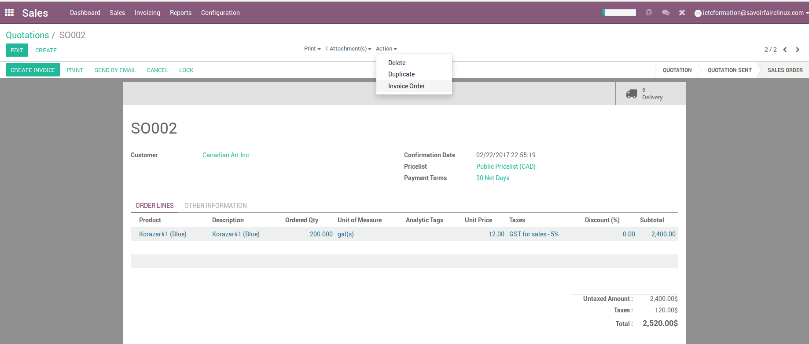
Sales – Invoice
CC-BY-NC-SA

Slide 39
Online Sales
CC-BY-NC-SA

Slide 40
Definition of E-Commerce
E-Commerce is a transaction of buying or selling online.
https://en.wikipedia.org/wiki/E-commerce
Commercial transactions conducted electronically on the Internet.
https://en.oxforddictionaries.com/definition/us/e-commerce
Business conducted through the use of computers, telephones, fax machines, barcode readers, credit cards, automated teller machines (ATM) or other electronic appliances (whether or not using the internet) without the exchange of paper-based documents. It includes activities such as procurement, order entry, transaction processing, payment, authentication and non-repudiation, inventory control, order fulfillment, and customer support. When a buyer pays with a bank card swiped through a magnetic-stripe-reader, he or she is participating in e-commerce.
http://www.businessdictionary.com/definition/electronic-commerce-E-Commerce.html
CC-BY-NC-SA

Slide 41
Types of E-Commerce/E-Business
B2B Business to Business Paypal (and B2C, B2B2C) Optize (and B2C) Alibaba Group | B2C Business to Consumer Amazon FreshDirect Zynga (and C2C) | B2G Business to Government « E-Procurement »
C2B Consumer to Business Zonzoo Fotolia Google Adsense | C2C Consumer to Consumer Prosper (P2P loans) eBay Facebook | C2G Citizen to Government Agencia Tributaria (Tax Agency online)
G2C Government to Citizen « E-Government » AEPM Certificado Digital | G2B Government to Business « E-Government » eDNI USA.gov (and G2B) | G2G Government to Government Government Gateway Schengen Information System
Not easy to classify
Many real e-business models fall into multiple catégories
CC-BY-NC-SA

Slide 42








E-Commerce Process
1
E-Commerce Business Strategy & Business Planning
Order Acceptance, Payment Processing, and Inquiry Response
2
E-Commerce Website Construction
Fulfillment
(Receipt of Goods, Picking, Packing, and Shipping) / Warehouse Management
Order
Fulfillment Formulation
3
Merchandise Shipment
Customer Care (Inquiry Contact Point)
Receipt of Goods
Internet Promotion (Acquisition)
Consumer
4
Return Processing / Inquiries After Purchase
CC-BY-NC-SA

Slide 43
Exercise – Online Service Sale
20 min
Canadian Colors has a great sales experience of its products and services online that allows a wide coverage at the national level.
Through its website, customers located in Ontario and Quebec can purchase and schedule services without having to travel to the nearest store. On the other hand, Canadian Colors sells and delivers products to any city in Canada.
Services Category
Tool Rental
Design Center
Cutting of materials
Product on request
CC-BY-NC-SA

Slide 44
Exercise – Online Service Sale
Canadian Colors provides customers with necessary tools and machinery to complete, repair, remodeling or construction projects that customers have in mind. Customers will be able to ask all their questions through the online chat to highly qualified consultants who will be willing to solve all their concerns and give you the best advice to carry out their projects.
For this exercise, students will take two different roles. First, you will play the role of customer to buy products online, then you will play the role of Canadian Colors’ employee to confirm the sales.
CC-BY-NC-SA

Slide 45
Exercise – Online Service Sale
CUSTOMER ROLE - Steps to rent a tool online:
From Canadian Colors’ website, select and quote on-line a tool from the list of tools (e.g Rotary Hammer Drill or Freem Mini Air Compressor)
Add to cart the tool that you have selected.
Continue the checkout process for this product
Fill out the contact form (all fields are mandatory)
Choose any kind of payment terms and confirm the purchase of the service
CC-BY-NC-SA

Slide 46
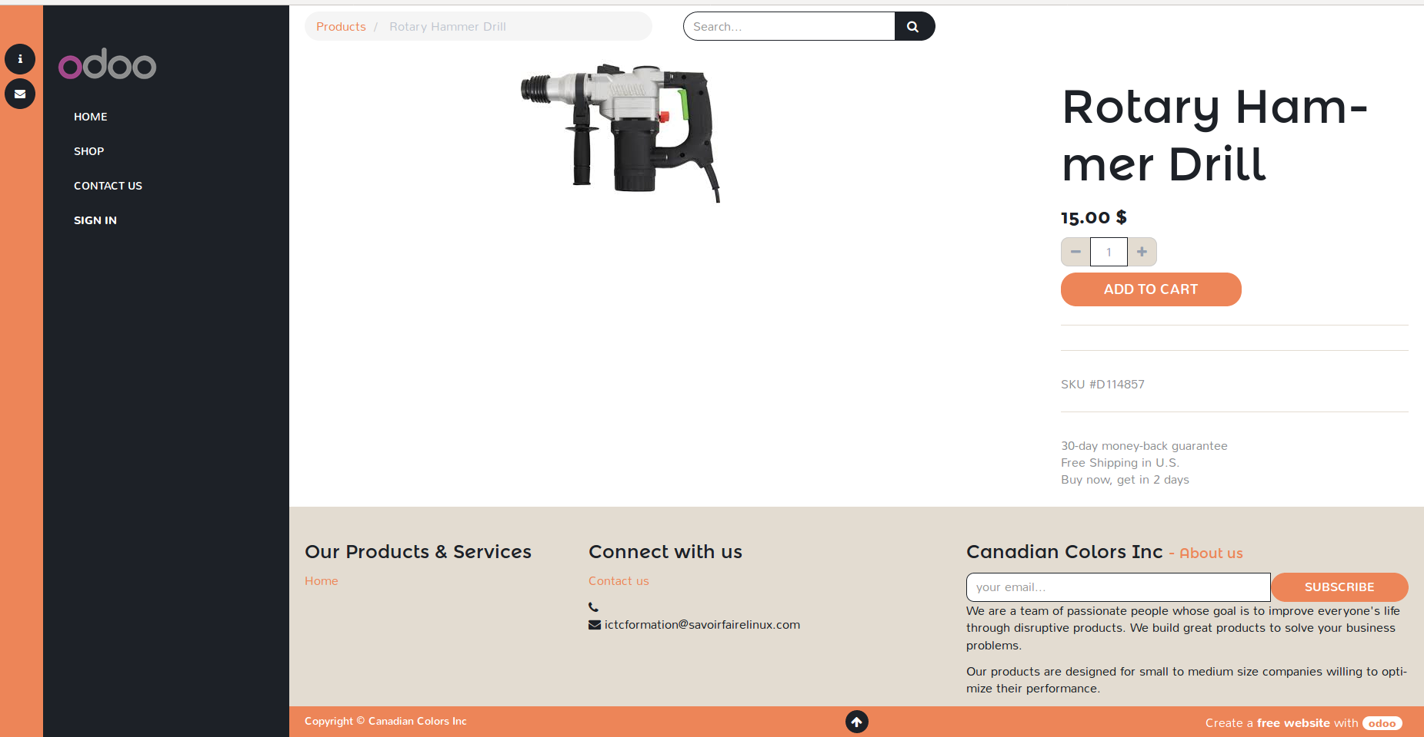
Site web – Online sales
CC-BY-NC-SA

Slide 47
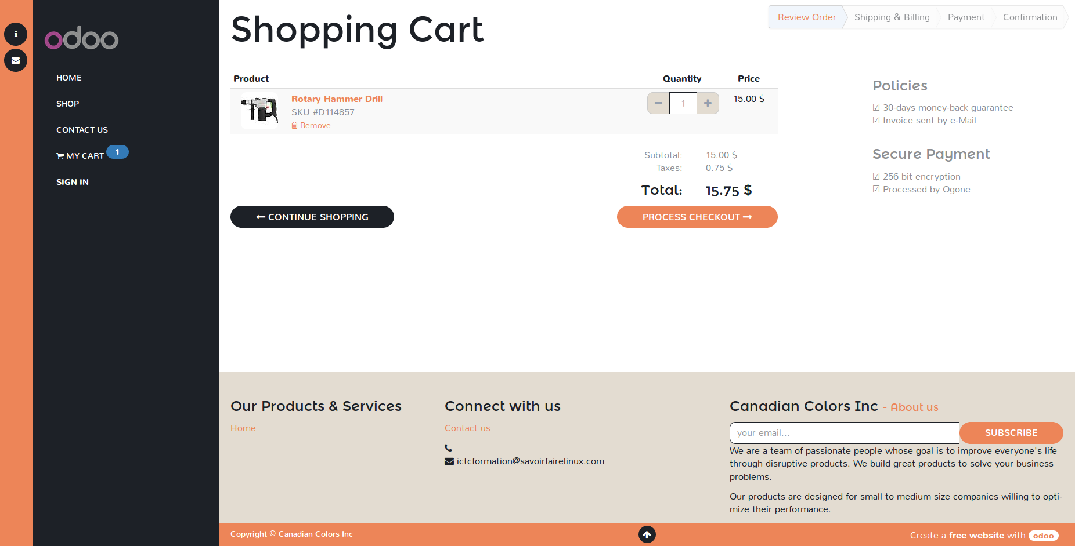
Sales – Online shopping process
CC-BY-NC-SA

Slide 48
Exercise – Online Service Sale
CANADIAN COLORS’ EMPLOYEE ROLE - CUSTOMER ROLE
Now it is time to change roles
CC-BY-NC-SA

Slide 49
Exercise – Online Service Sale
CANADIAN COLORS’ EMPLOYEE ROLE
Go into the Sales module, to confirm the quotation generated by the system as a result of the customer's online purchase.
Validate product and quantities to confirm the sales order
Generate the delivery order confirming the available quantities of the product
Create and send by email the invoice
Confirm the delivery of the rented product by the customer
CC-BY-NC-SA

Slide 50
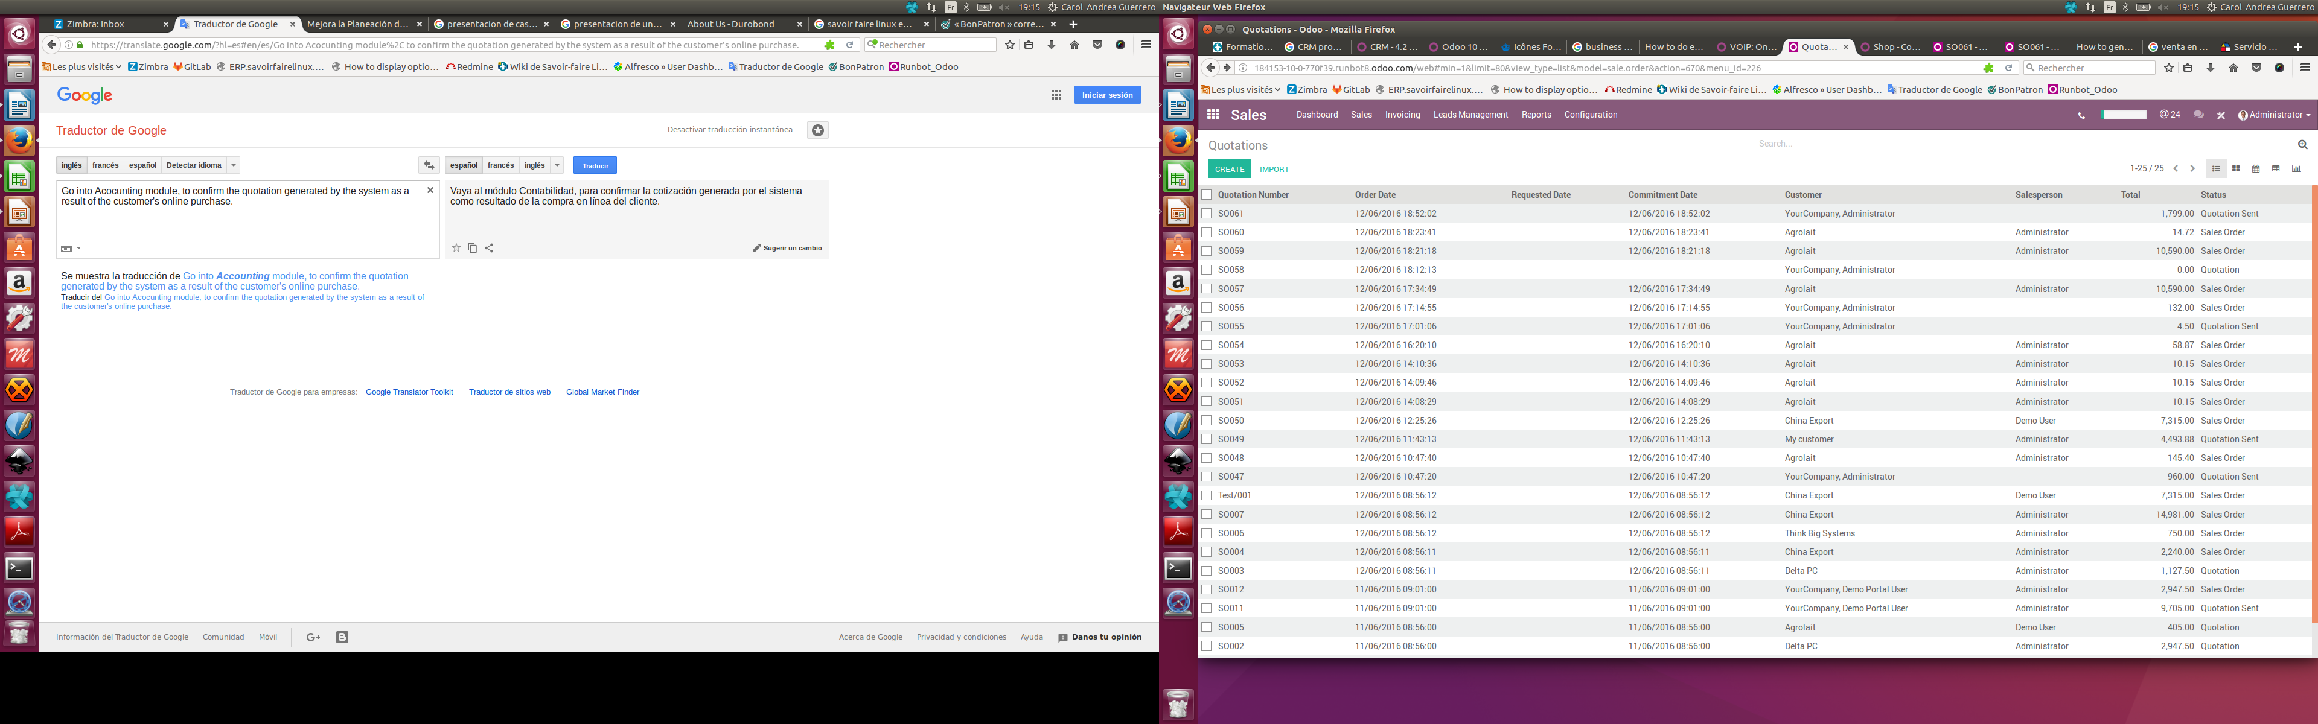
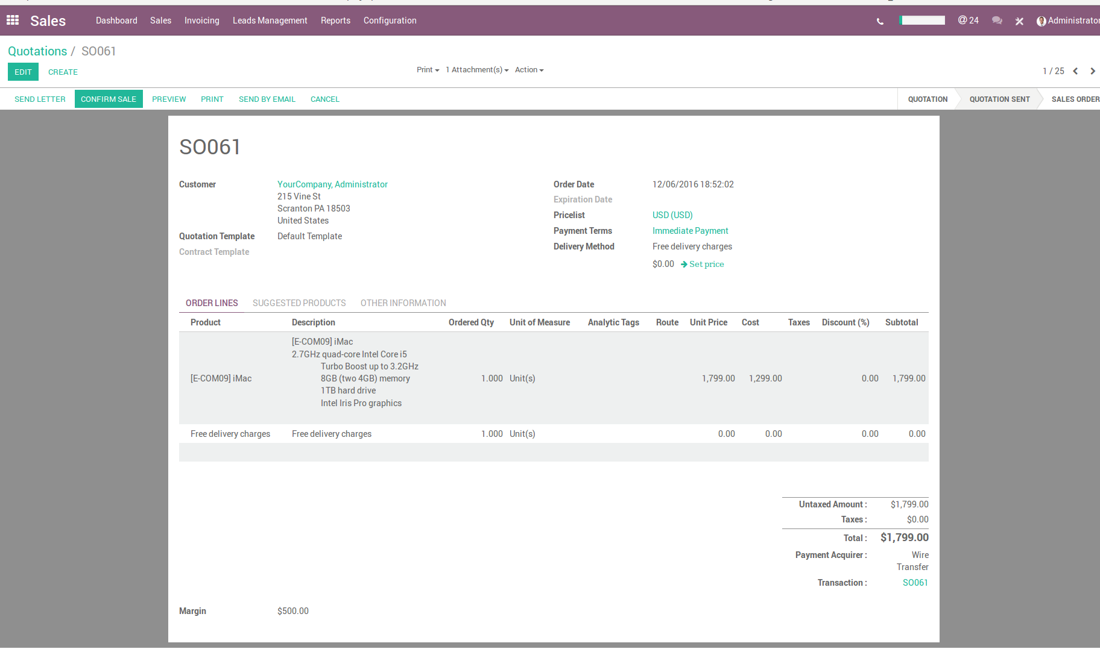
Sales – Confirm quotation and generate purchase order
CC-BY-NC-SA

Slide 51
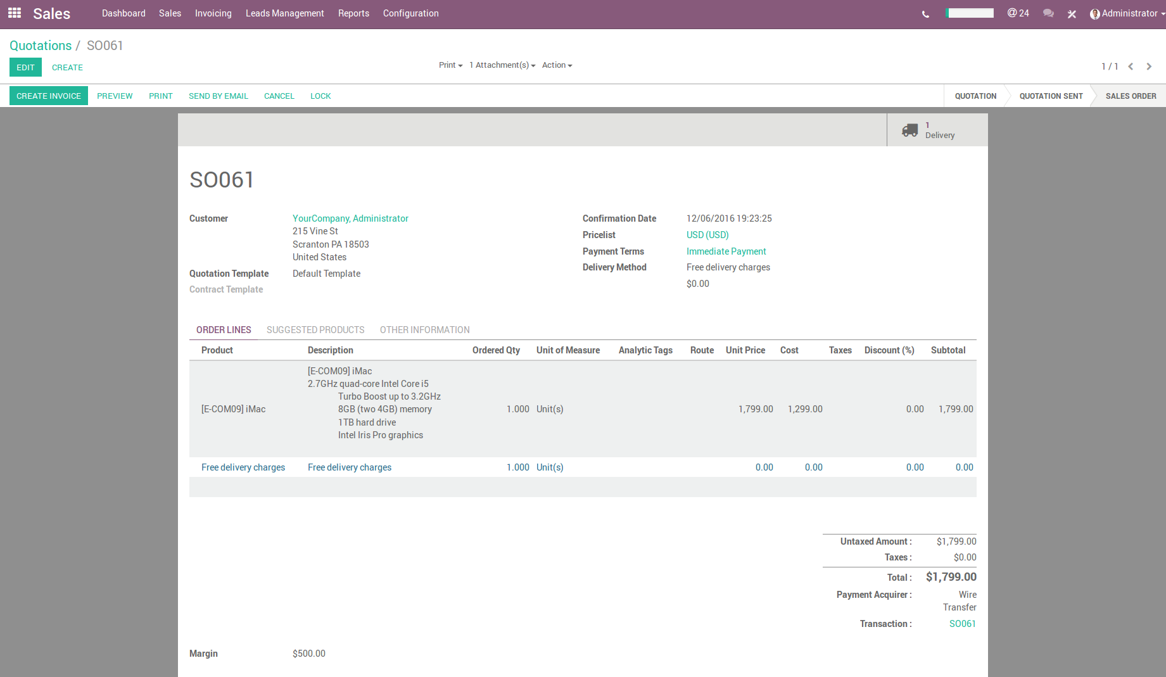
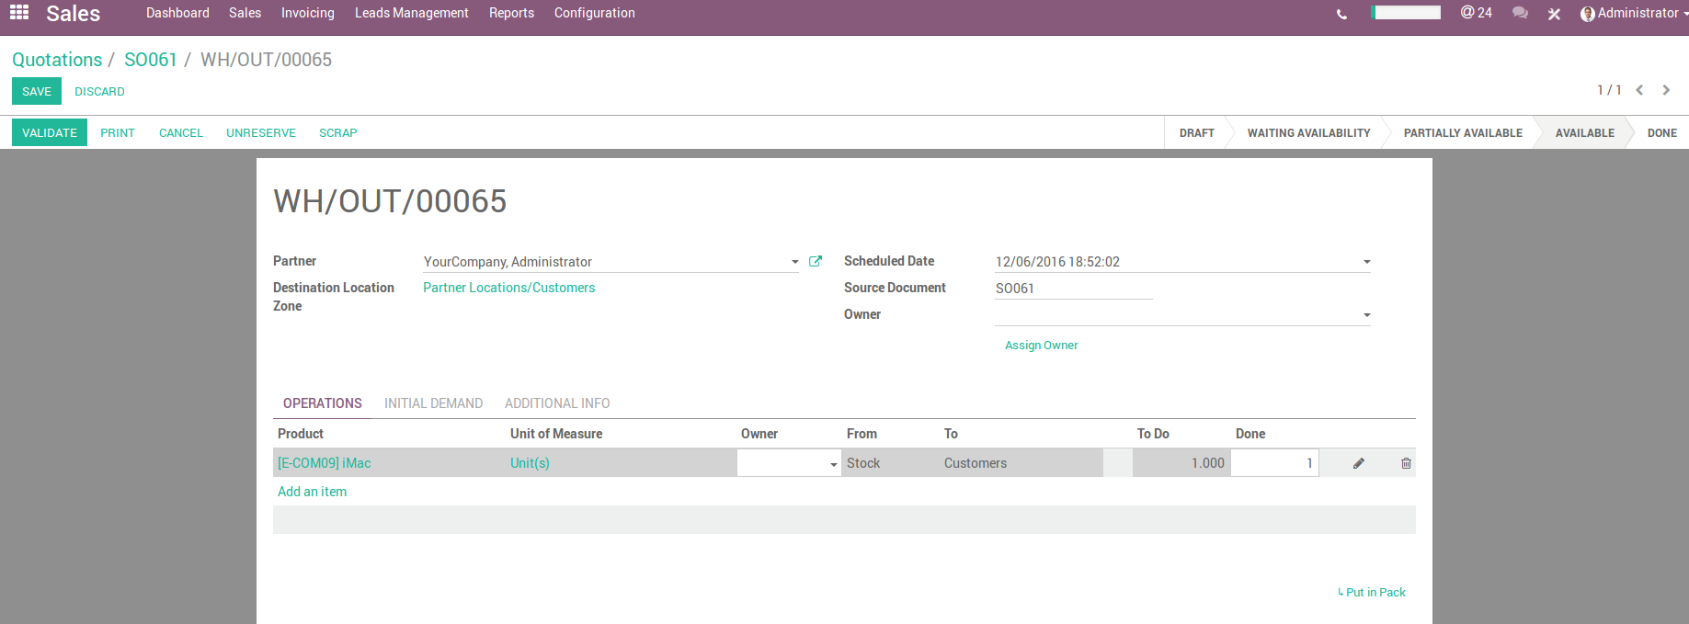
Sales – Generate delivery order
1
CC-BY-NC-SA

Slide 52
ROI & Tracking marketing campaign
CC-BY-NC-SA

Slide 53

Return on Investment – ROI
Return on investment (ROI) is a measure of the profit earned from each investment. It is typically expressed as a percentage.
SALES
PROFITS
X
PRICE
ROI
MARGINS
-
FIXED
COST
COST
-
INVESTMENT
VARIABLE
COST
CC-BY-NC-SA

Slide 54
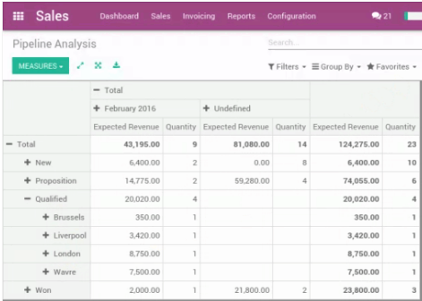
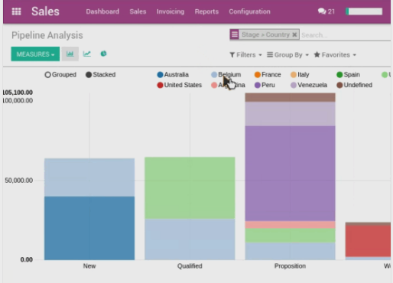
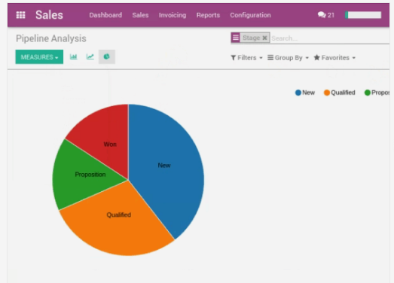
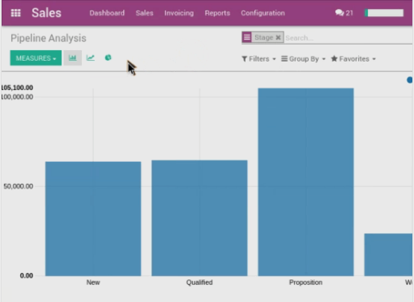
Sales – Marketing ROI Calculation
You can calculate your ROI by following opportunities through Odoo CRM and analyzing :
the conversation rate,
the expected revenue,
and the genereted revenue of each campaigns.
CC-BY-NC-SA

Slide 55
Example – Marketing ROI Calculation
Example applied according to the launching campaign of the new product « HomeColor » of « Canadian Colors Inc ».
CC-BY-NC-SA

Slide 56
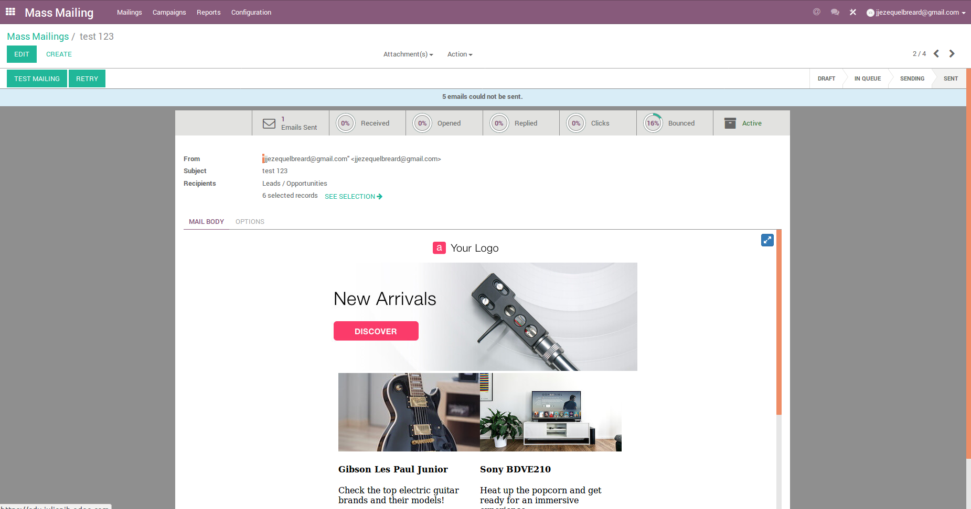
Sales – Tracking marketing campaigns
Odoo allows tracking mass-mailings through performance indicators.
CC-BY-NC-SA

Slide 57
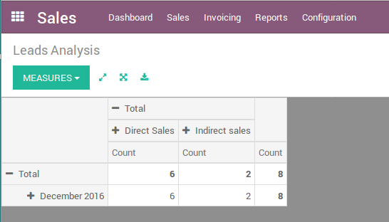
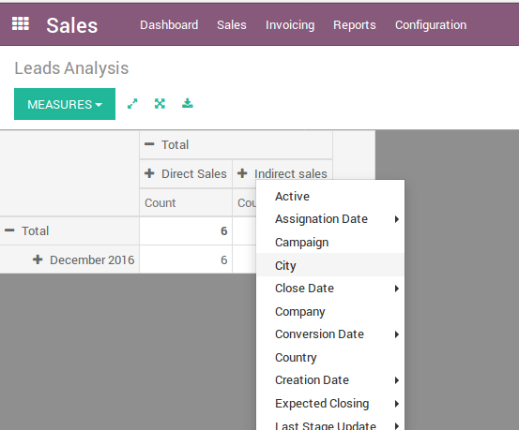
Sales Reports
The Reports feature allows you to easily create analysis directly from Odoo.
Odoo allows you to have a quick overview on your leads, and analyze them with the axis you want. In the given example, the axis is sales team.
CC-BY-NC-SA

Slide 58
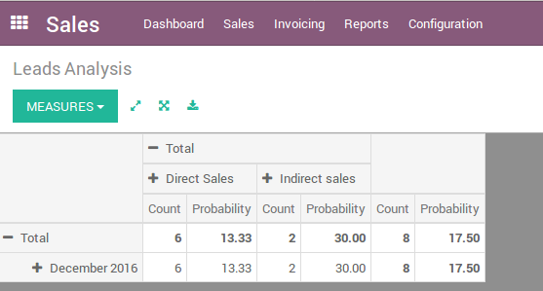
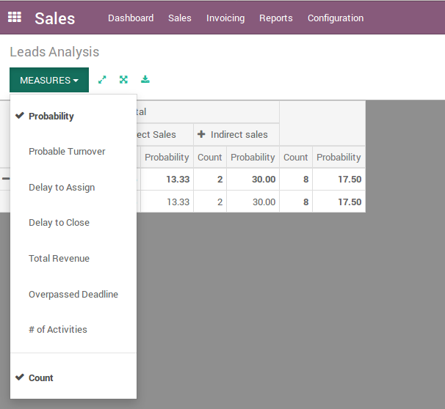
Sales Reports
You can choose one or several measure units, depending on what information and analysis you need.
CC-BY-NC-SA

Slide 59
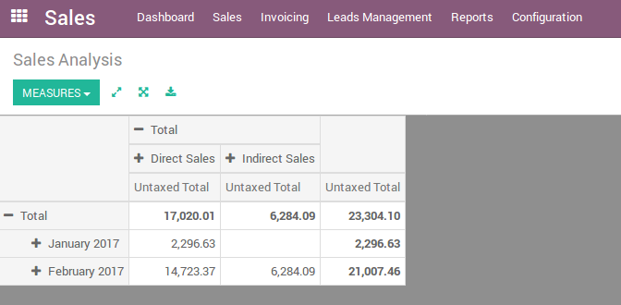
Sales Reports
CC-BY-NC-SA

Slide 60
Customer Satisfaction
CC-BY-NC-SA

Slide 61


Why Customer satisfaction is important
Net Promoter Score vs. Satisfaction Surveys
CC-BY-NC-SA

Slide 62
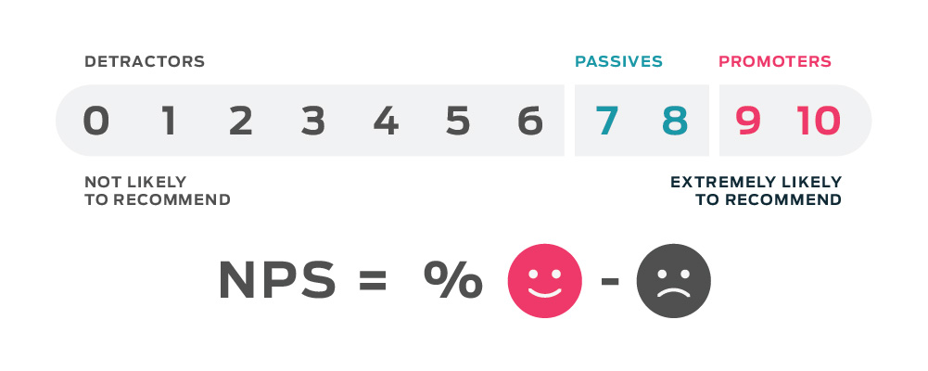
Net Promoter Score
How likely would you recommend us to a friend?
CC-BY-NC-SA

Slide 63
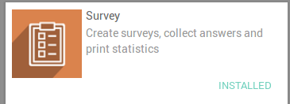
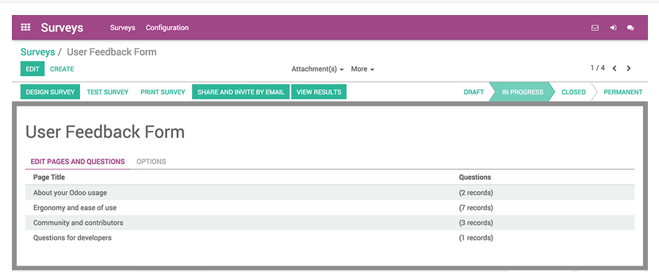
Sales – Survey
Manage automate appraisals, satisfaction surveys, marketing campaign, feedback forms, etc.
CC-BY-NC-SA

Slide 64
Example – Customer Satisfaction Survey
“Canadian Colors Inc” wants to evaluate the service provided by its by its employees in the sales department. For this, the company has designed a survey that will be completed by customers once their purchase is completed. Take the information of the following survey and design one in Odoo Survey.
Customer Satisfaction Survey
Tell Us About Your Experience
How satisfied were you with our service today?
Very Satisfied
Satisfied
Not Satisfied
Is this the first time you have used our service?
Yes
No
If you have used our service before, how many times in the past year?
Would you recommend us to a friend?
Yes
No
CC-BY-NC-SA

Slide 65
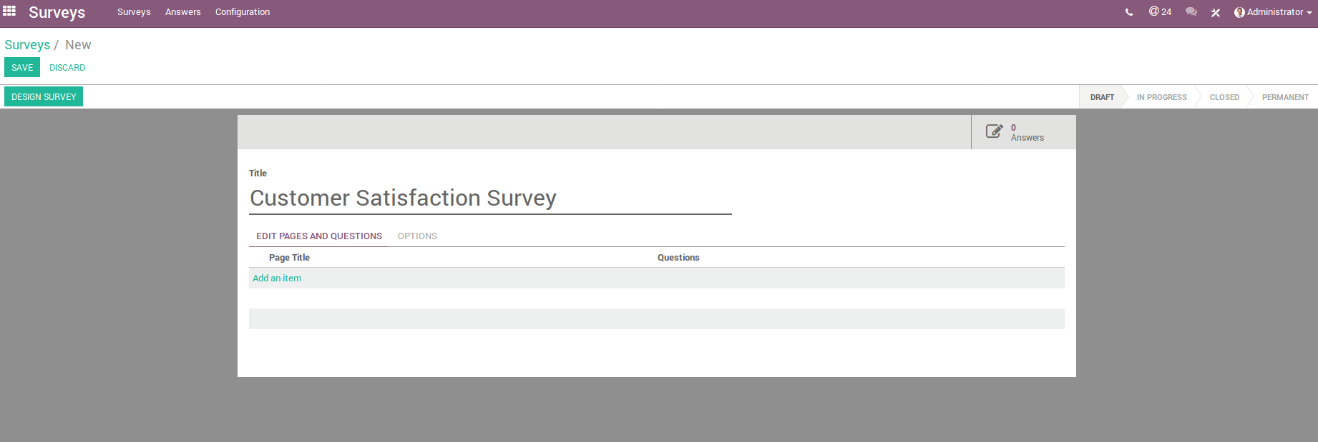
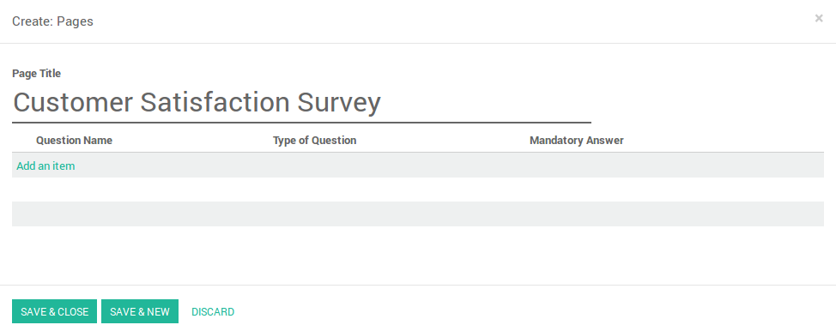
Sales – Survey
CC-BY-NC-SA

Slide 66
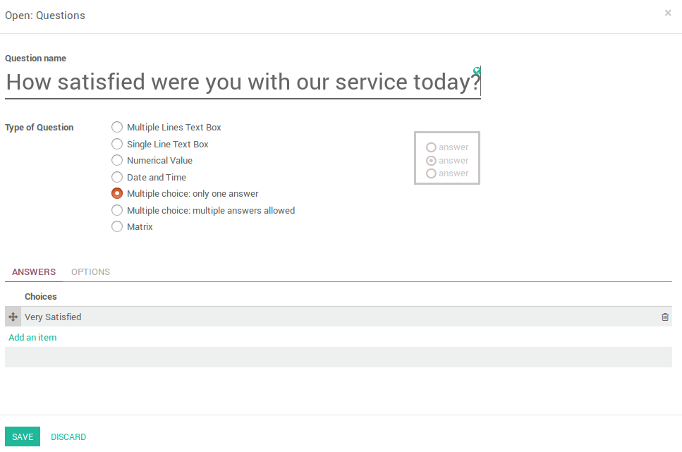
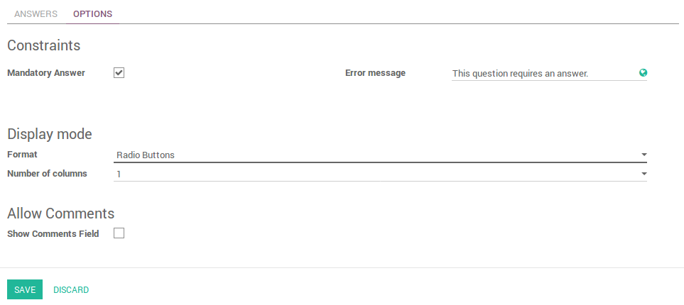
Sales – Survey
CC-BY-NC-SA

Slide 67
Questions?
CC-BY-NC-SA

Slide 68

Solutions de gestion informatique
LICENCE : CC-BY-NC-SA

